Slide 1


TEAM - TECHNO MAVERICKS
PastGuard
“SAFEGUARIDNG THE HISTORY, ENSURING TOMORROW”
For Reckon 5.0

Slide 2
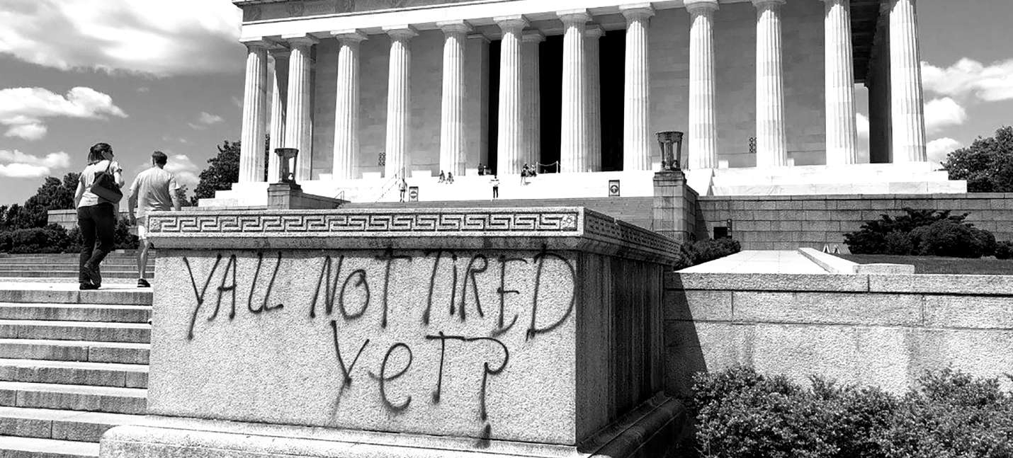

THE PROBLEM: HISTORY AT STAKE?
Cleanliness and Hygiene
No one appreciates their visit to be ruined by chips packets and empty bottles.
Tourist Management
Slow lines? Lost items? Theft?
So much for an organized
and planned tourist experience.
Vandalism
Drawings, writings, symbols, posters? All ruining the beauty of an architectural marvel.

Slide 3

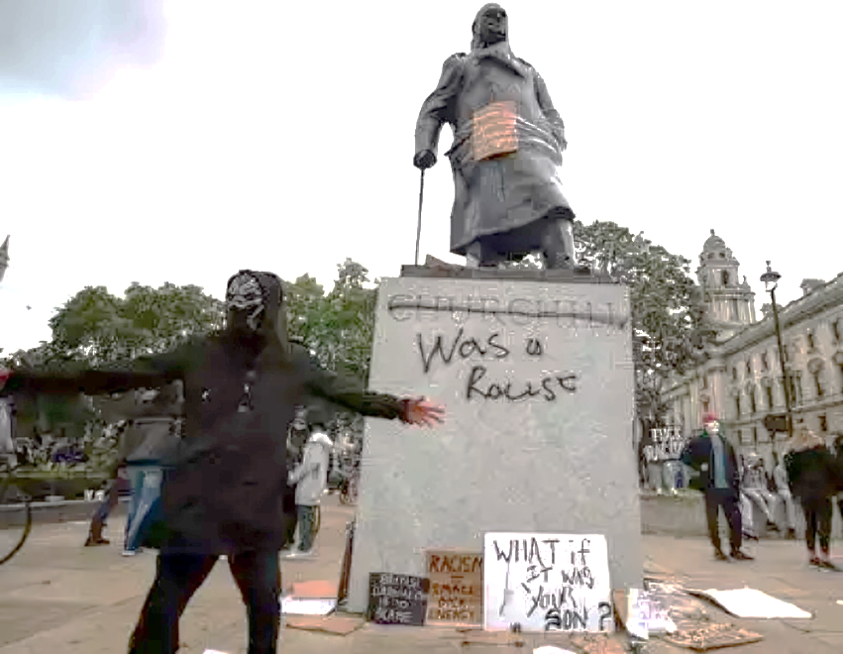
OUR SOLUTION:
PASTGUARD
An all-encompassing system, PastGuard offers complete surveillance and control to the authoritires.
Vandalism Surveillance
Cameras enhanced with vandalism detection and face recognition Machine Learning models.
Litter Detection
Machine Learning models trained to detect littering and tag the defaulters.
Reverse Lost-&-Found
Systems to retrieve misplaced personal items of tourists and detect theft.
QR-Based Ticketing System Comprehensive QR-based online ticketing system for convenience and safety.

Slide 4

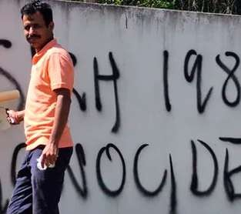





VANDALISM SURVEILLANCE
Using ML models specially trained to detect Vandalism on walls and tag the offenders.
Surveillance cameras detect vandalism, tag and identify the offender and send their data to the central management system.

Slide 5
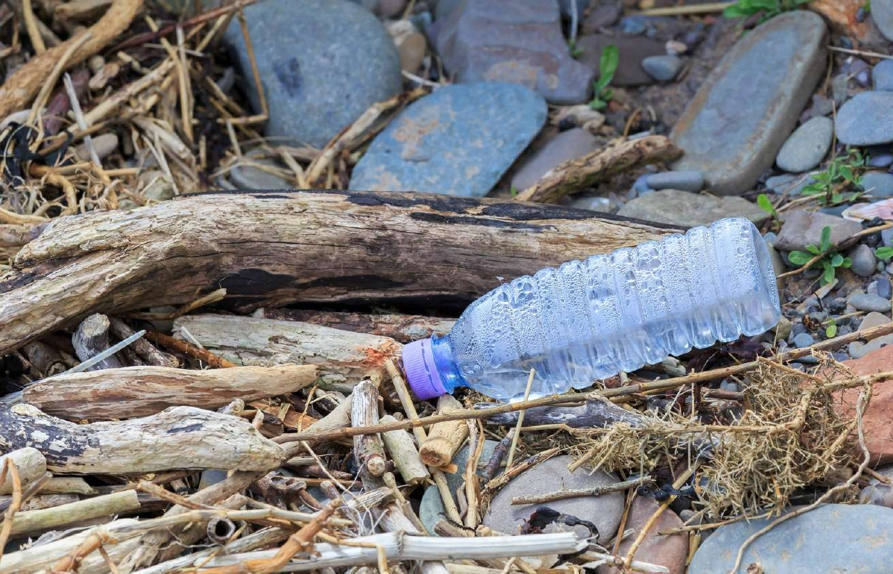
LITTER DETECTION
Cameras detect any litter stable for a long period of time.
the litter is retraced through videofeed
to first instance of apperance.
the felon is defined and
contacted using facial recognition.
Vision
Using ML models specially trained to detect litter items like bottles and packets.
Items are then traced to their first instance, and the data of the guilty visitor is shared to the central system.

Slide 6

Finding a Way to Retrieve Belongings
Surveillance cameras able enough to detect any lost bags and trace it’s original owners.
Cameras detect any baggage kept
still for a long period of time.
Bag retraced through videofeed to first instance of apperance.
REVERSE
LOST-AND-FOUND
Owner of the Bag defined and
contacted using facial Recognition.

Slide 7
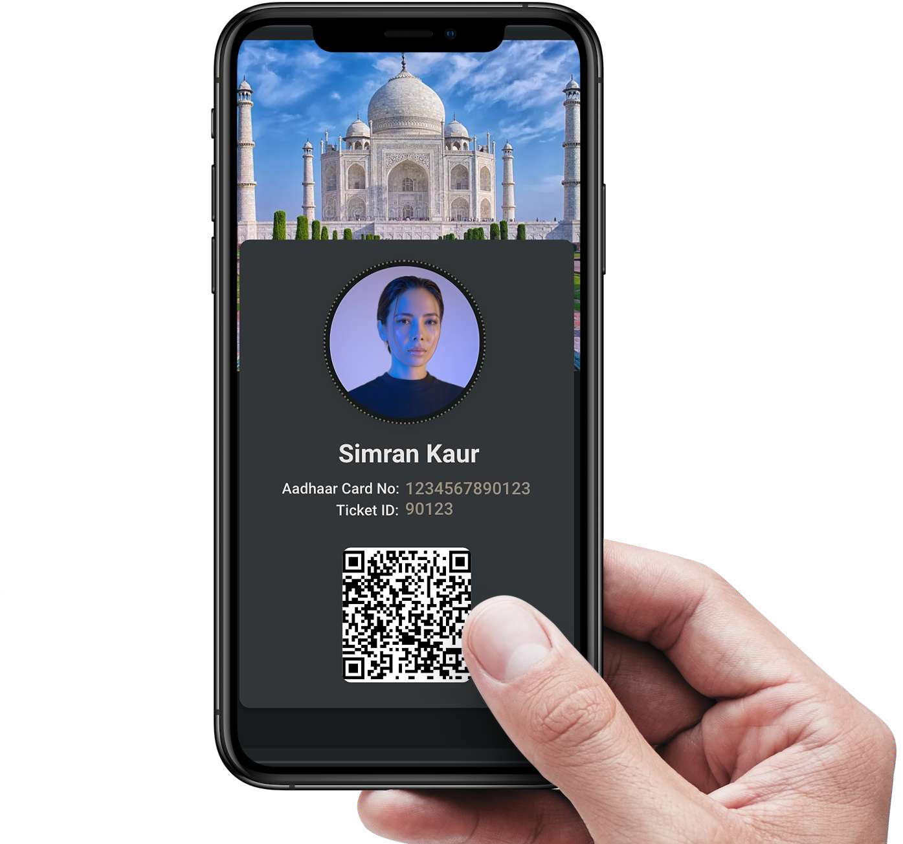

QR-BASED
TICKETING SYSTEM
Date:
24th Feb 2023
Taj Mahal Agra, India
Tickets booked online and user
pre-verified using KYC.
Skipping the Hastle
PastGuard allows tourists to pre-book and pre-verify their tickets, ensuring a comfortable experience.
The system also stores facial recogntion data and baggage data for easy retrieval in case of misplacement.
Upon arrival, user scans QR for entry
and facial data scanned for security.
Belongings of the user also scanned
and tagged to user’s data.

Slide 8




Presented By:
TEAM - TECHNO MAVERICKS
THANK YOU
ENSURING TOMORROW

